Slide 1
Fundamentals
of Programming (Week 1)
Name: Sheikh Thanbir Alam
Deg: Senior Software Programmer
Org: Army War Game Center, BD Army

Slide 2

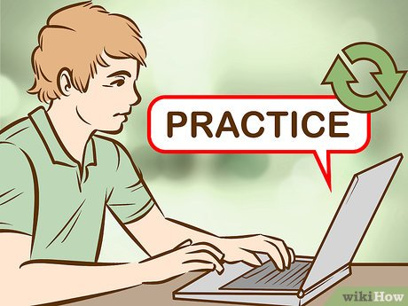
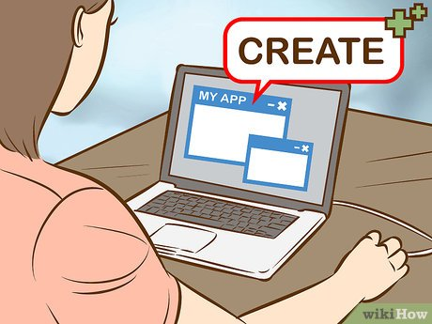
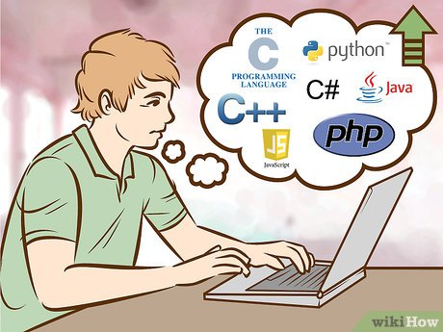
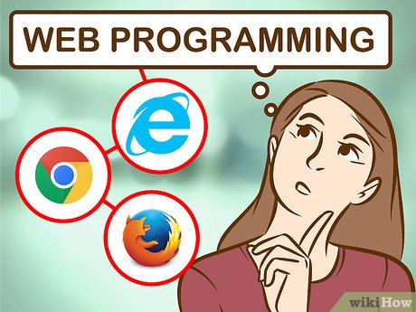
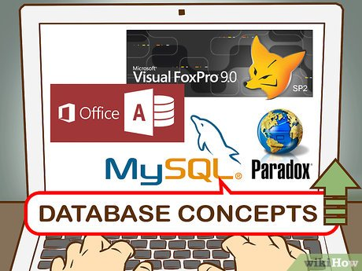
Why We are Here?

Slide 3
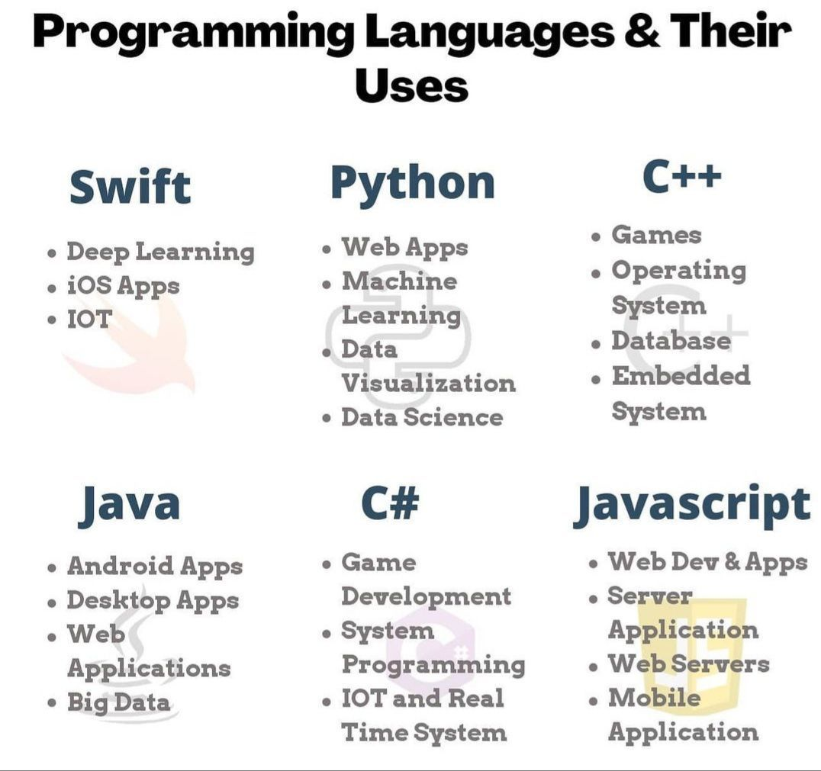
Which language should we learn?
Yes, there are over 300 programming languages, but you don't need to know them all, and you'll find that each language serves a specific purpose (or several). Compared to spoken languages, most are pretty easy to learn.

Slide 4
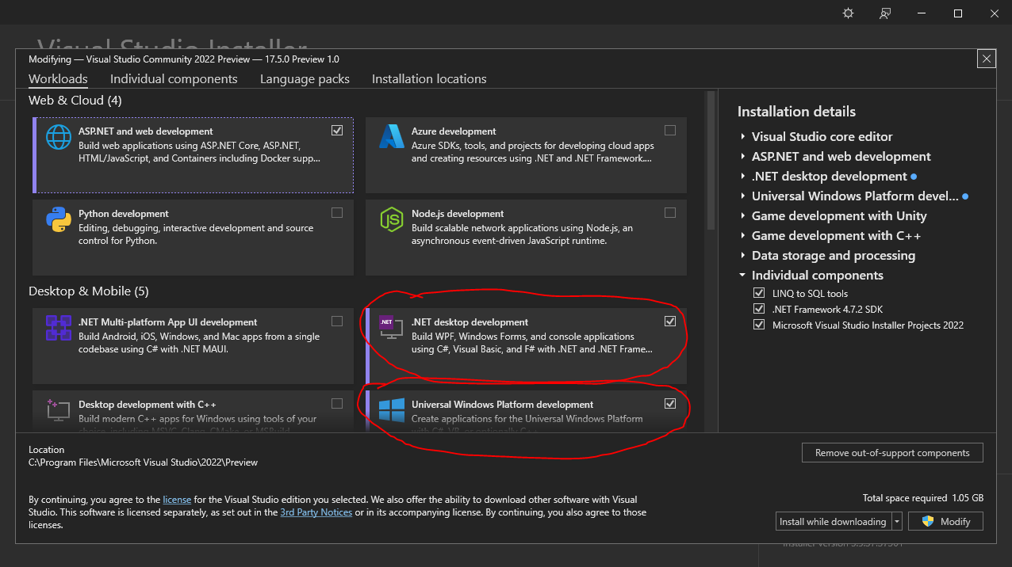
Installation Process (Visual Studio & C#)
Download Visual Stdio 2022 Preview Community Version (Link)
Install (Video Link); It may take 2-3 hours, depends on your internet.

Slide 5
Basic Syntax
Let’s Print Our Institute Name in C#.
Let’s Print Our Three Friends Name.
Let's Take Input of Our Parents Name and Print.
Let’s Take Input a Number and Print.
Let’s Take 2 Number and Print the Sum.

Slide 6


